Slide 1
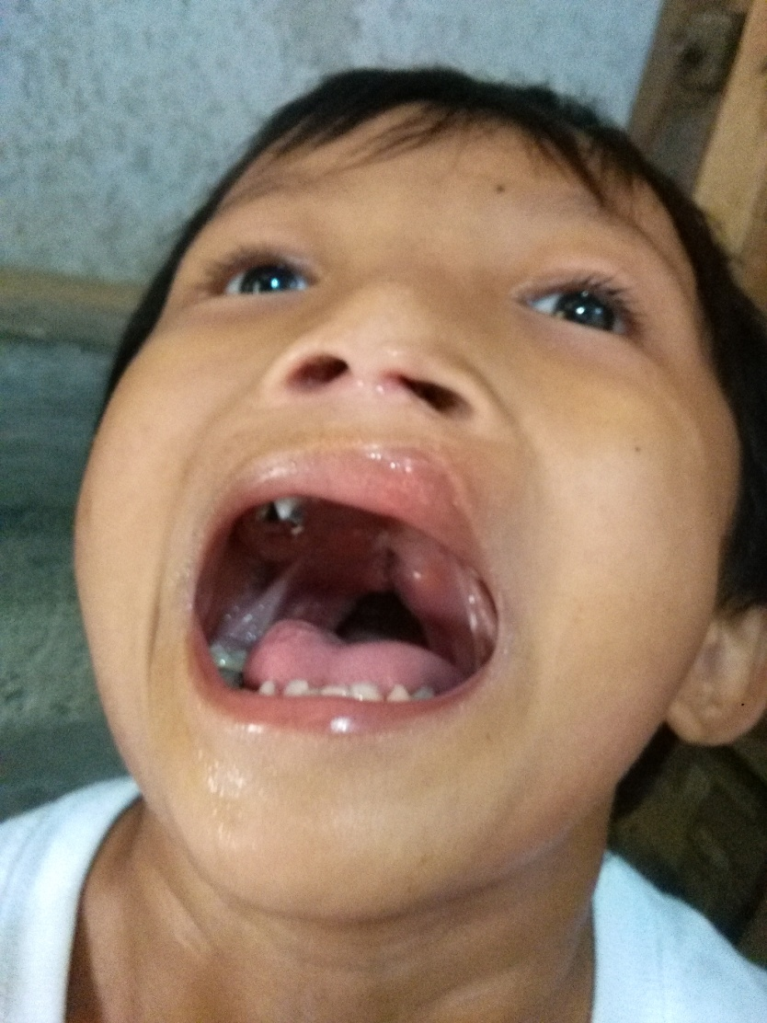
Reynold Sapuez July 31, 2016
This is the present
palate of Reynold.
The Doctors of
Philippine Bond of Mercy
scheduled his
third operation
on November 2016.
If he is in a good physical
condition, the operation will pursue.

Slide 2
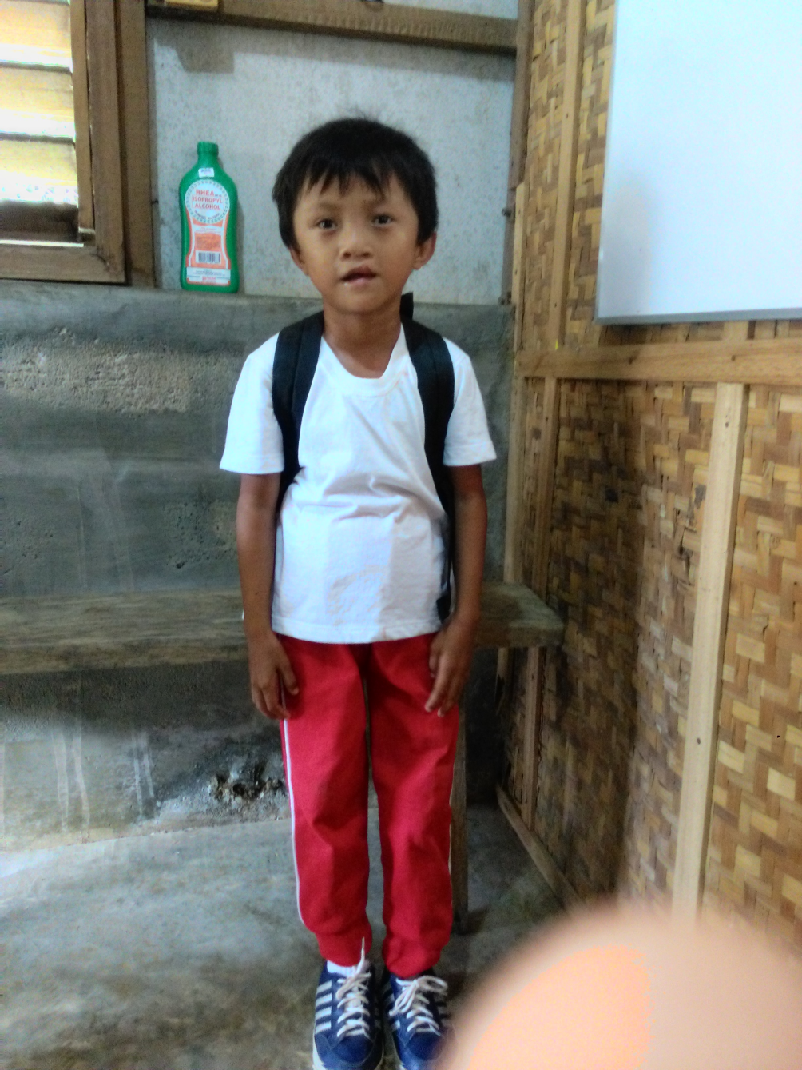
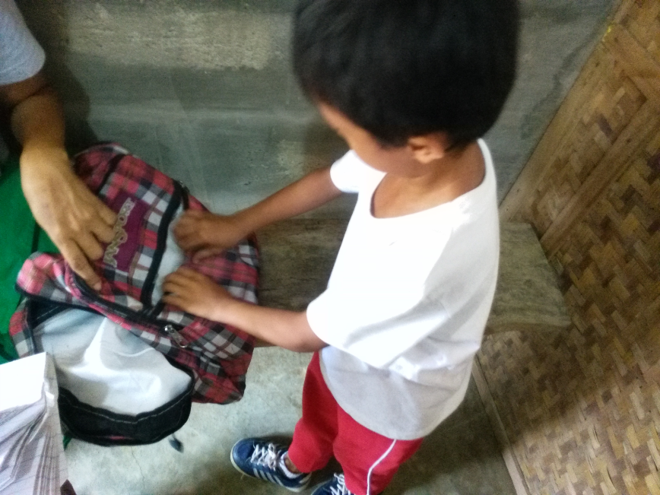
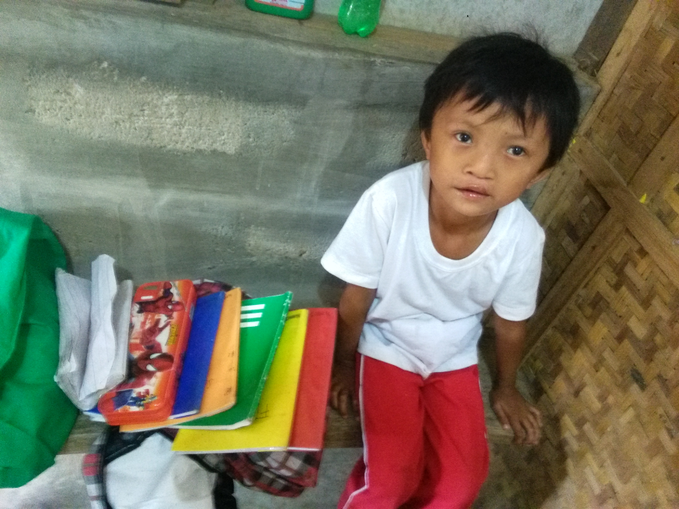
This is Reynold wearing his Physical Education uniform and his rubber shoes. On the right side, he is with his bag and with his school notebooks.
(He wears the Physical Education uniform every Friday.)

Slide 3
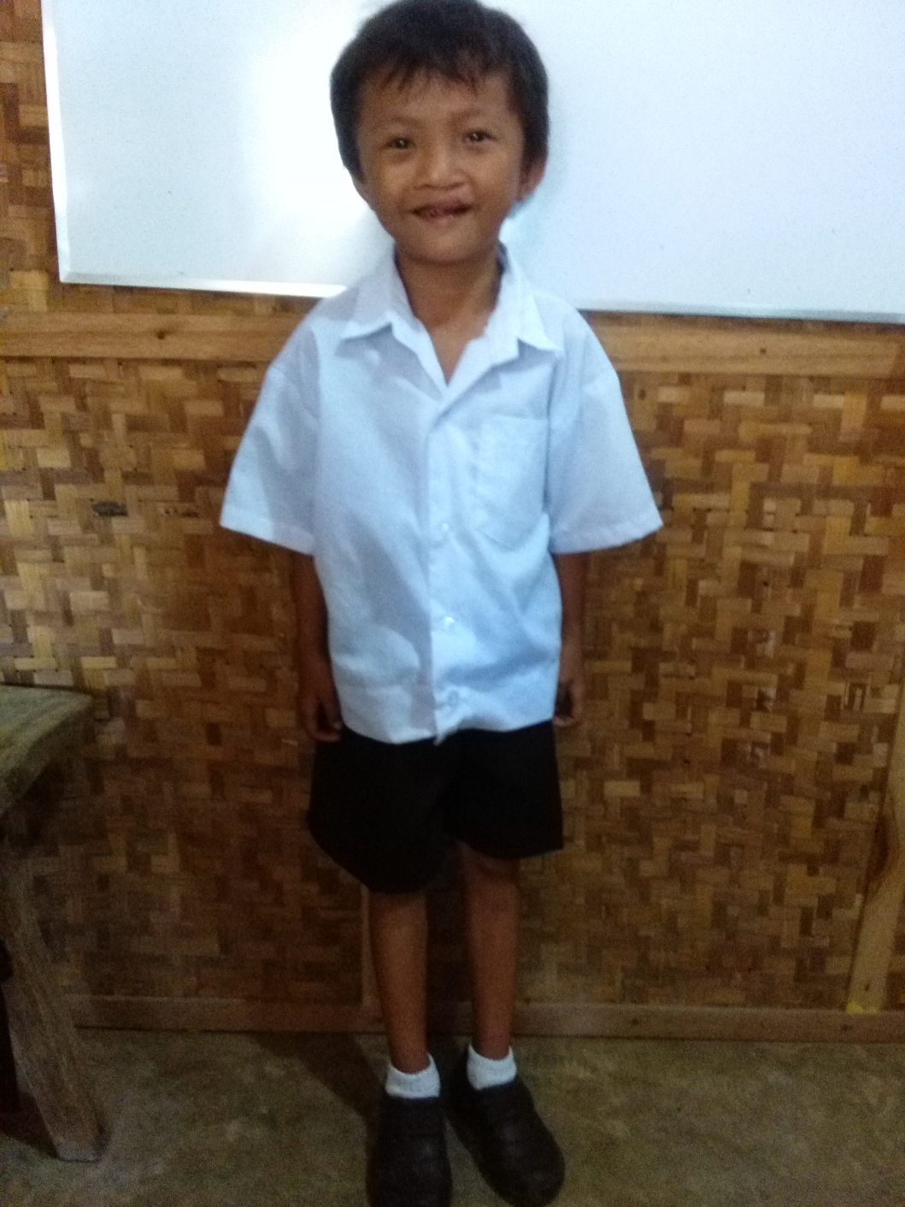
This is Reynold in his school uniform and with his black shoes which he wears from Monday to Thursday. He was so happy to wear it and he said, “ I’m already similar to my classmates .”
Reynold goes to preparatory class.
In his present condition, words are
still impossible to understand because
only sounds can be heard from his mouth.
But he was so grateful to all who helped him particularly to you Sabrina who provided not only for his needs in the operation but also for his educational needs.
We are joyfully awaiting also that day when
he will be able to pronounce real words but even though his smile already expresses how happy he is now.

